Slide 1
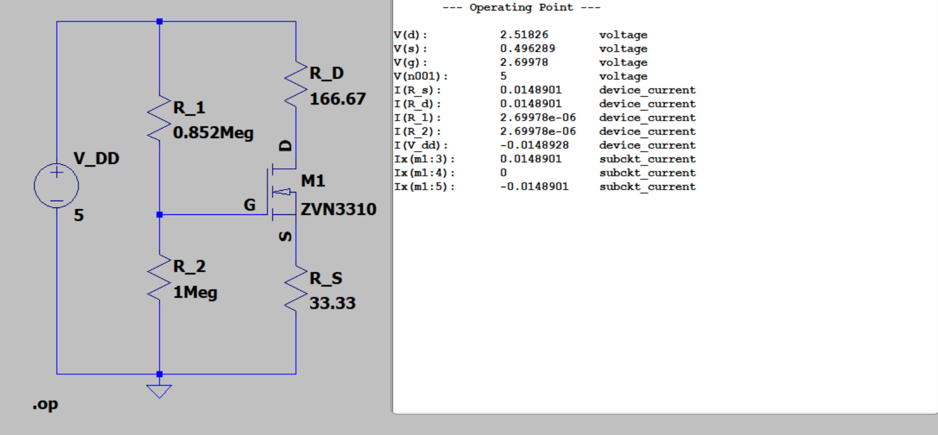
Exercise 12

Slide 2
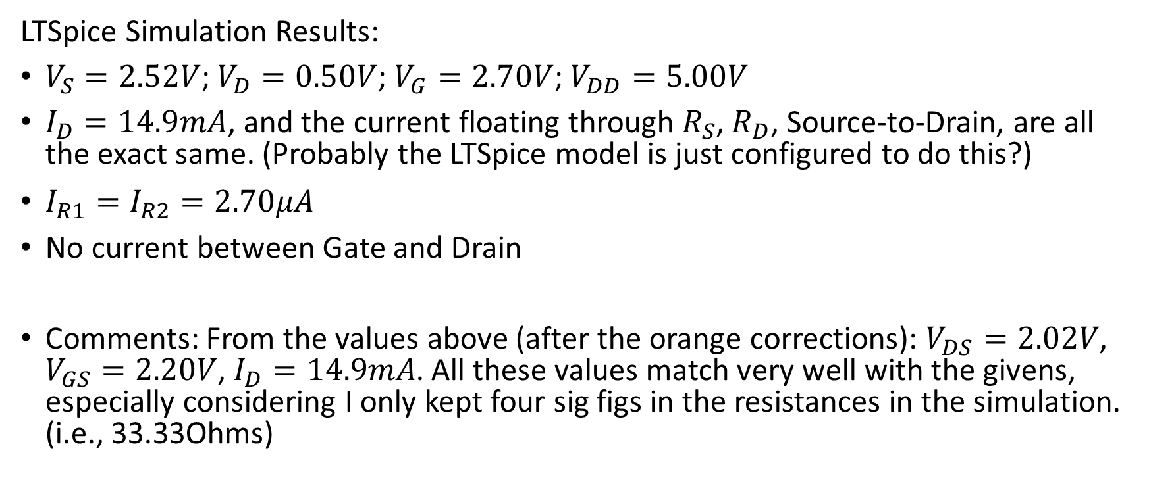
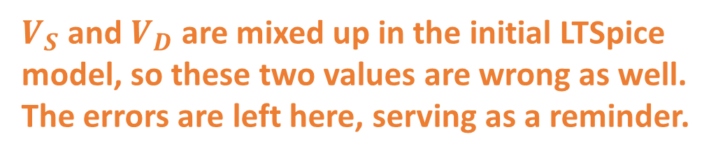
Exercise 12
$V_{S}$ and $V_{D}$ are mixed up in the initial LTSpice model, so these two values are wrong as well.
The errors are left here, serving as a reminder.
LTSpice Simulation Results:
$V_{S}=2.52V$; $V_{D}=0.50V$; $V_{G}=2.70V$; $V_{DD}=5.00V$
$I_{D}=14.9mA$, and the current floating through $R_{S}$, $R_{D}$, Source-to-Drain, are all the exact same. (Probably the LTSpice model is just configured to do this?)
$I_{R1}=I_{R2}=2.70μA$
No current between Gate and Drain
Comments: From the values above (after the orange corrections): $V_{DS}=2.02V$, $V_{GS}=2.20V$, $I_{D}=14.9mA$. All these values match very well with the givens, especially considering I only kept four sig figs in the resistances in the simulation. (i.e., 33.33Ohms)

